Slide 1




Kn w your numbers – Conditions of use
Please ensure you read through this information pack before using any of the equipment . Please sign below to confirm you are happy to continue and understand use of the equipment is voluntary and with your agreement:-
Name:
Email Add:
Signature:
If you do have any concerns with any of your measurements, you should speak with your own GP or a Doctor
You can also speak to a doctor or nurse via the employee assistance helpline on 0800 015 5630. Further information can be found on SSENET
KNOW
Y UR
NUMBERS

Slide 2
Kn w your numbers – Conditions of use
All use of the equipment is with your consent and at your own risk
There is no identified risk in using any of the equipment but the full user & safety guidelines are available for you to read through if you require them or if you have any concerns
This pack also includes the main instructions from these guidelines covering use of the body analysis scales and blood pressure monitors
No advice will be given at these sessions
Included within this pack is some information to help you interpret your results. This information is sourced from either the equipment booklets themselves or from official NHS or medically approved sites
If you do have any concerns with any of your measurements, you should speak with your own GP or a Doctor
You can also speak to a doctor or nurse via the employee assistance helpline on 0800 015 5630. Further information can be found on SSENET
KNOW
Y UR
NUMBERS

Slide 3
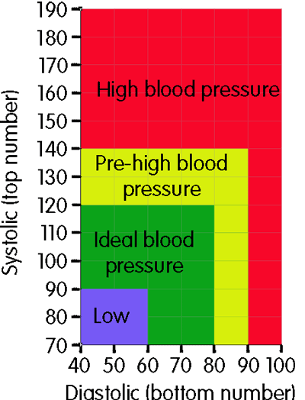

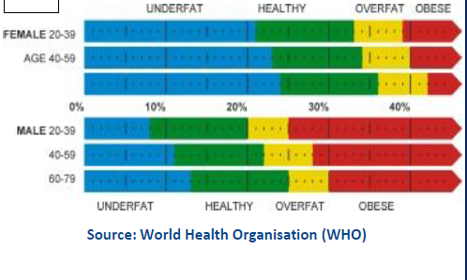


What do my results mean ?
KNOW
Y UR
NUMBERS
Heart rate
Most adults have a resting
heart rate of between 60-80
beats per minute (bpm).
The fitter you are, the lower your
resting heart rate is likely to be.
For example, athletes may have a
resting heart rate of 40-60 bpm or
lower. You should contact your GP
if you think your heart rate is
continuously above 120 bpm or
below 40 bpm, although this could
just be normal for you.
Healthy body fat percentage ranges
Source: NHS.co.uk
Source: Blood Pressure UK
Source: World Health Organisation (WHO)
Woman: Average of estimated bone mass
Source: Tanita Body Weight Science Institute
Weight (lb)
Less than 110 lb | 110 lb – 165 lb | 165 lb and up
4.3 lb | 5.3 lb | 6.5 lb
Weight (kg)
Less than 50 kg | 50 kg – 75 kg | 75 kg and up
1.95 kg | 2.40 kg | 2.95 kg
Healthy Body Water % Range
45-60%
Men: Average of estimated bone mass
Source: Tanita Body Weight Science Institute
50-65 %
Weight (lb)
Less than 143 lb | 143 lb – 209 lb | 209 lb and up
5.9 lb | 7.3 lb | 8.1 lb
Weight (kg)
Less than 65 kg | 65 kg – 95 kg | 95 kg and up
2.65 kg | 3.29 kg | 3.69 kg
Source: Tanita’s own internal research

Slide 4
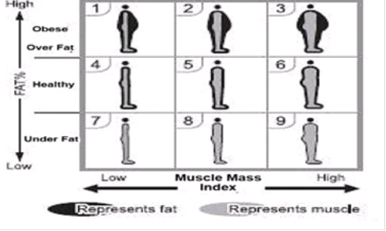


What do my results mean ?
KNOW
Y UR
NUMBERS
Muscle Mass
Source: Columbia University New York
Daily Calorie Intake (DCI) is an estimate
of how many calories (Kcal) or
kilojoules (KJ) you can consume within the next 24 hours to maintain your current weight. A standard equation using weight and age is used to calculate your Basal Metabolic Rate (BMR) , which is the minimum amount of calories your body needs to function effectively. You burn around 70% of calories for basal metabolism. Additional energy is used up when doing any kind of exercise.
Visceral Fat reading
Metabolic Age
If your BMR age is higher than your actual age, it is an indication you need to improve your metabolic rate. Increased exercise will build healthy muscle tissue which will improve your metabolic age.
Healthy Level 1- 12
Excess level 13-59
Source: Columbia University New York
Daily Calorie Intake (DCI)’ is the sum of calories for
basal metabolism, daily activity metabolism
(activities including daily household chores),
and a diet induced thermogenesis (energy used
in connection with digestion, absorption,
metabolism, and other eating activities). It is
an estimate of how many calories you can
consume within the next 24 hours to maintain
your current weight.

Slide 5
Kn w your numbers – Height Conversion chart
KNOW
Y UR
NUMBERS

Slide 6
Personal record sheet - body composition readings
Name: Height :
Age:
Employee assistance helpline: 0800 015 5630

